Slide 1



Log Analyzer
based LogLLM
for VS Code
Group：Git Commit
日期：2025/11/19

Slide 2


01
项目背景与目标
目录
02
核心技术方案
03
敏捷开发流程
04
测试与实验结果
05
项目成果与未来工作

Slide 3

01
项目背景与目标

Slide 4
01-日志异常检测的学术演进与瓶颈
日志的重要性
系统日志是软件可靠性研究的核心观测载体，记录了软件运行时的状态和事件，为调试、性能监控和可靠性保障提供关键信息。
现有方法的局限性
当前日志异常检测方法存在三难困境：云端大模型导致隐私不可控，IDE缺乏统一分析接口，传统工具对复杂日志支持不足，解析准确率与效率难以兼顾。
研究目标
本研究旨在提出一种基于LogLLM的本地化大模型方案，满足高解析性能、零隐私出域和IDE原生体验三项严苛指标，为日志异常检测提供新的工程化范式。

Slide 5
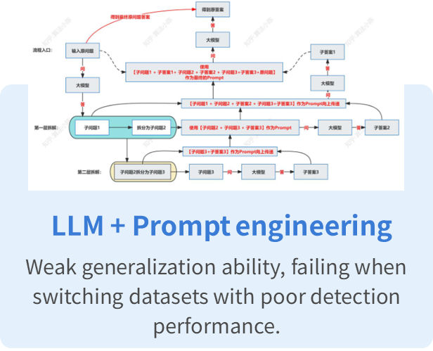
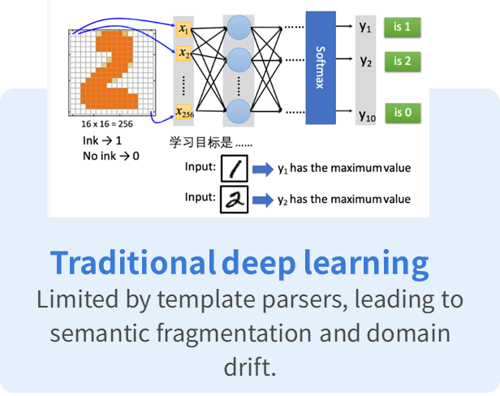
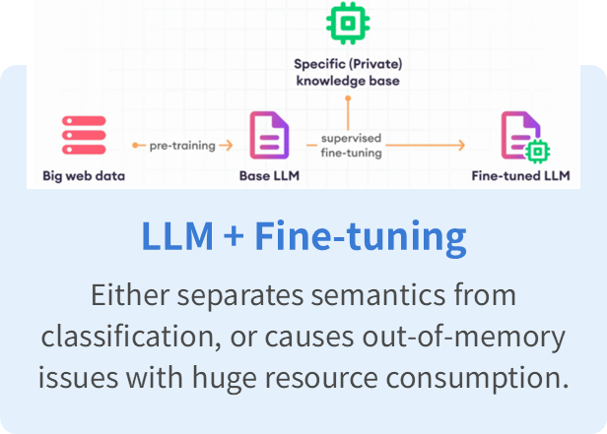
01-Clear the Bottlenecks

Slide 6
02
核心技术方案

Slide 7

02-Technical Challenges
Key information extraction
Implement advanced NLP techniques to accurately identify and extract essential log patterns and parameters from raw data, eliminating noise while preserving meaningful semantic information for precise analysis.
Priority Ranking
Develop intelligent algorithms to automatically classify and rank detected anomalies by severity and urgency, enabling developers to focus on critical issues first and optimize troubleshooting efficiency.
VS Code Integration
Seamlessly embed the anomaly detection engine into VS Code's extension ecosystem, ensuring real-time log monitoring, native UI components, and uninterrupted performance within the developer's existing workflow.

Slide 8
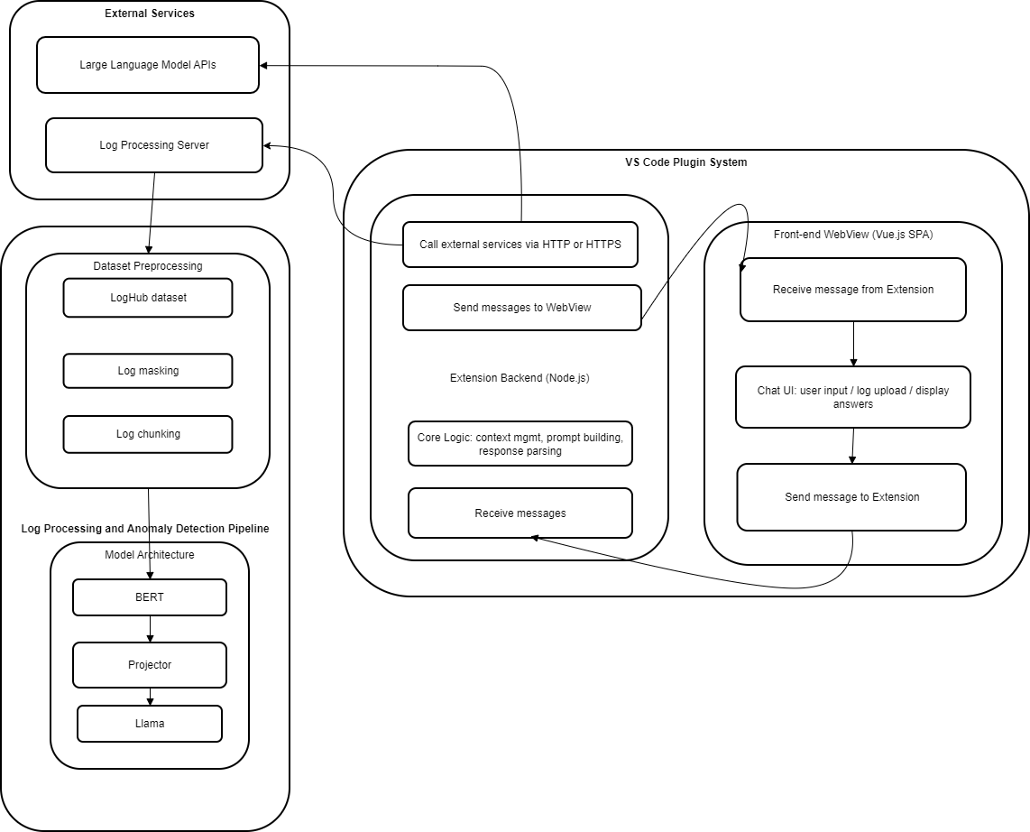

02- System Architecture
Diagram
This figure illustrates the system architecture of the VS Code plugin for anomaly log parsing based on LogLLM, which consists of three core components: left-side External Services (LLM APIs, Log Processing Server), middle VS Code Plugin System backend (Node.js-based for core logic/communication), and right front-end WebView .
A clear data flow links user requests, the log processing/anomaly detection pipeline (BERT+Projector+Llama model architecture), and result presentation, creating an efficient, secure IDE-integrated log analysis solution.

Slide 9
02- back & front
back
front
The plugin's frontend is a Vue.js single-page application embedded in the VS Code WebView, sending and receiving messages via postMessage, and updating the UI through Pinia to achieve real-time interaction.
The plugin's backend runs in the Node.js environment provided by VS Code, monitors frontend messages, processes core business logic, returns results via encapsulated interfaces, and ensures the security of sensitive information.

Slide 10
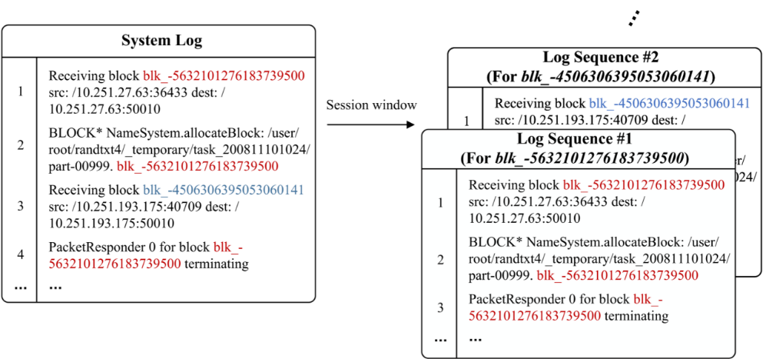
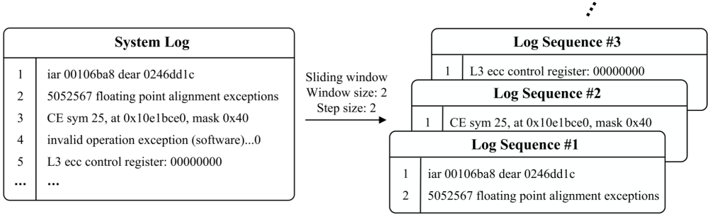
02- 日志预处理
分片策略
正则脱敏
Pattern: IP address: '\d{1,3}\.\d{1,3}\.\d{1,3}\.\d{1,3}(:\d{1,5})?', MAC address: '([0-9A-Fa-f]{2}:){11}[0-9A-Fa-f]{2}', File Path: '[a-zA-Z0-9]*[:\.]*([/\\]+[^/\\\s\[\]]+)+[/\\]*' Before: 2354412 floating point alignment exceptions ;-; 2354412 floating point alignment exceptions iar 001061e8 dear 0247015c ;-; iar 00106200 dear 0247016c ;-; iar 001061b4 dear 024701dc ciod: Received signal 15, code=0, errno=0, address=0x000001f2 10668 total interrupts. 0 critical input interrupts. 0 microseconds total spent on critical input interrupts After: <*> floating point alignment exceptions ;-; <*> floating point alignment exceptions ;-; <*> floating point alignment exceptions iar <*> dear <*> ;-; iar <*> dear <*> ;-; iar <*> dear <*> ;-; iar <*> dear <*> ;-; iar <*> dear <*> ciod: Received signal <*>, code=<*>, errno=<*>, address=<*> <*> total interrupts. <*> critical input interrupts. <*> microseconds total spent on critical input interrupts
01
02

Slide 11
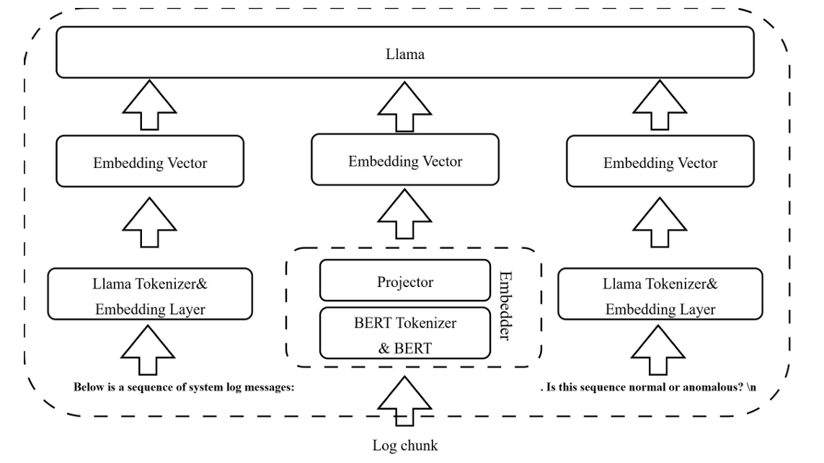
02- LogLLM模型
Datasets
LogLLM Framework
Dataset | Description | Type | Size
HDFS | Hadoop distributed file system log | Distributed system | 1.47GB
BGL | Blue Gene/L supercomputer log | Super computer | 708.76MB
Thunderbird | Thunderbird supercomputer log | Super computer | 29.60GB
Linux | Linux system log | Opreating system | 2.25MB
Apache | Web server error log | Server application | 4.90MB
Bert+Lama+Projector
Evaluation Metircs
Precision:Reduce false positives
Recall: Reduce false negatives
F1-score:Comprehensive perrformance

Slide 12

02- 前端框架与通信流程
通信流程
前端框架
消息序列
通过VS Code API双向通信实现命令调用与结果回显，确保前后端协同工作。
前端采用WebView+Node.js后端架构，WebView负责渲染Vue界面，Node子进程托管LogLLM与评分服务。
明确消息序列与异常回调机制，保障系统稳定运行，提升用户体验。

Slide 13
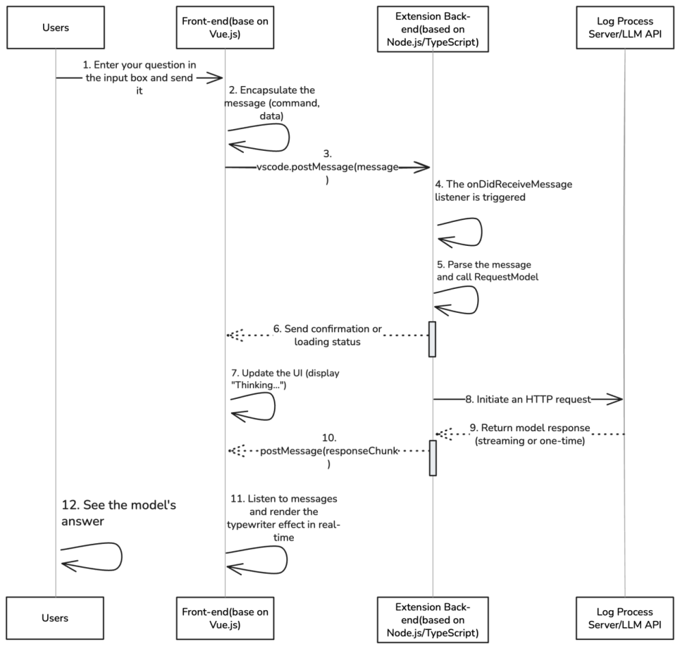
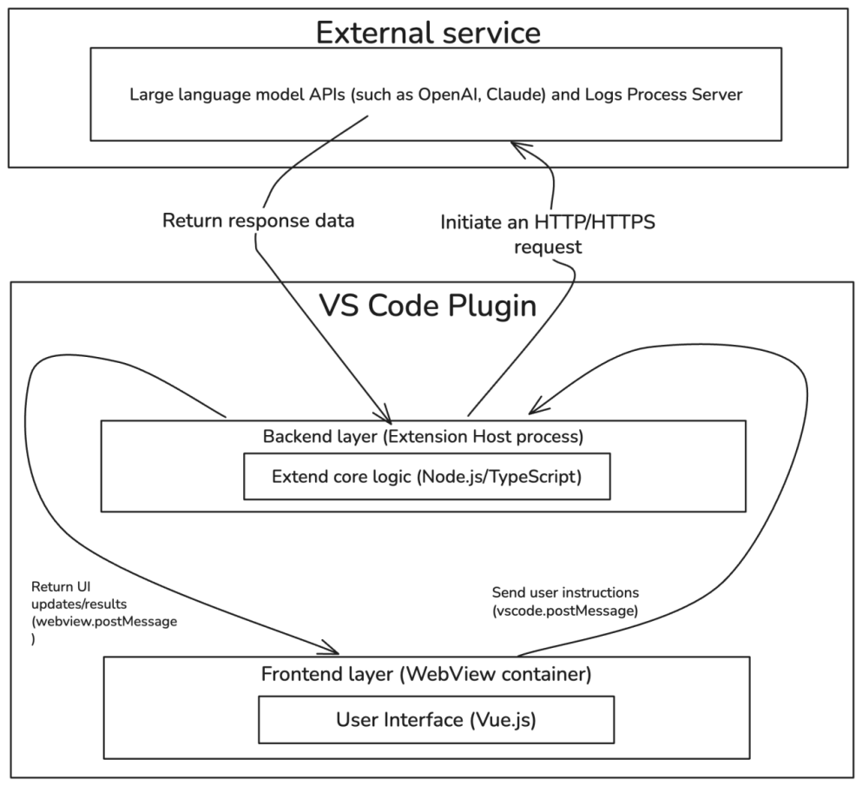
02- 前端实现
Framework of Front-end
Front-end interaction

Slide 14
03
敏捷开发流程

Slide 15

03- 需求与架构设计（sprint1）
01
02
03
需求澄清
用户故事
规格说明
聚焦需求分析与架构设计
召开需求研讨会明确用户故事、技术调研验证可行性
配置开发环境，并产出需求规格说明书和系统架构图

Slide 16

03- 前后端开发与模型集成 （sprint2）
前后端开发
前后端开发，涵盖后端服务搭建与LogLLM模型集成、前端界面实现，前后端数据通信对接
模型集成与交付
以及自定义prompt等功能的完善，交付可运行插件原型

Slide 17
03- 测试优化与交付成果 （sprint3)
03
02
01
交付成果
优化改进
多维度测试
撰写测试报告与用户手册，交付v1.0插件包。
修复内存泄漏与长日志阻塞问题，新增深色主题与快捷键，提升用户体验。
进行功能、性能、安全、兼容四维度测试，确保系统稳定可靠。

Slide 18
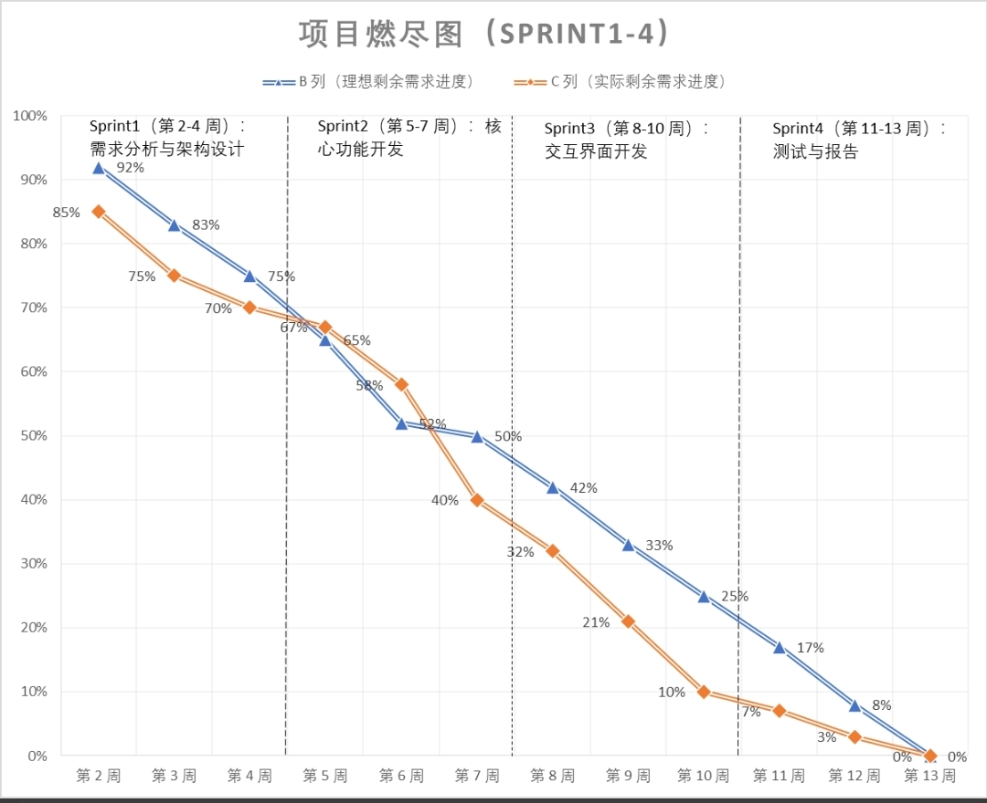
03- Burndown Chart
燃尽图展示
展示Sprint1-4燃尽图，纵轴为剩余Story Point，横轴为周次，曲线呈稳步下降。

Slide 19
04
测试与实验结果

Slide 20
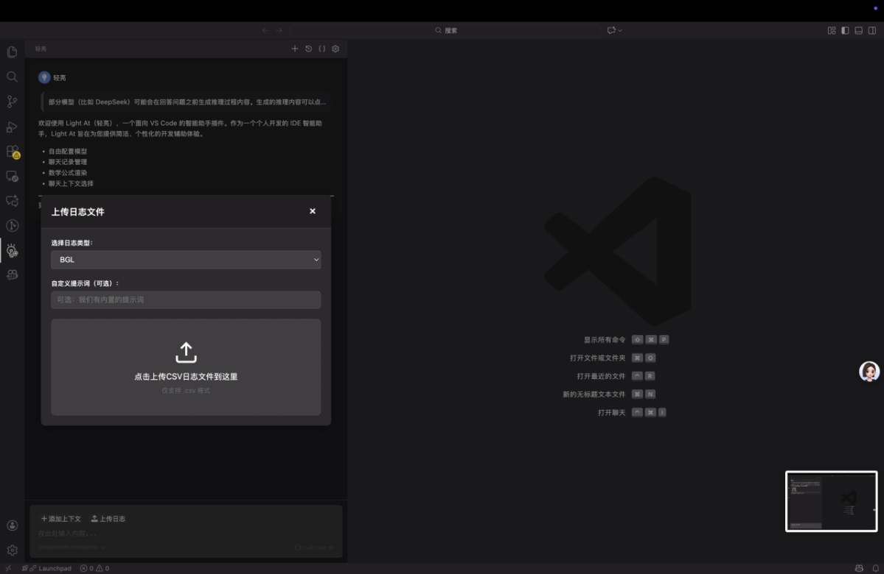
04- User Experience Flow- 1
Log File Upload
Interface
展示日志文件上传界面，突出零配置上手特性，方便用户快速导入日志。

Slide 21
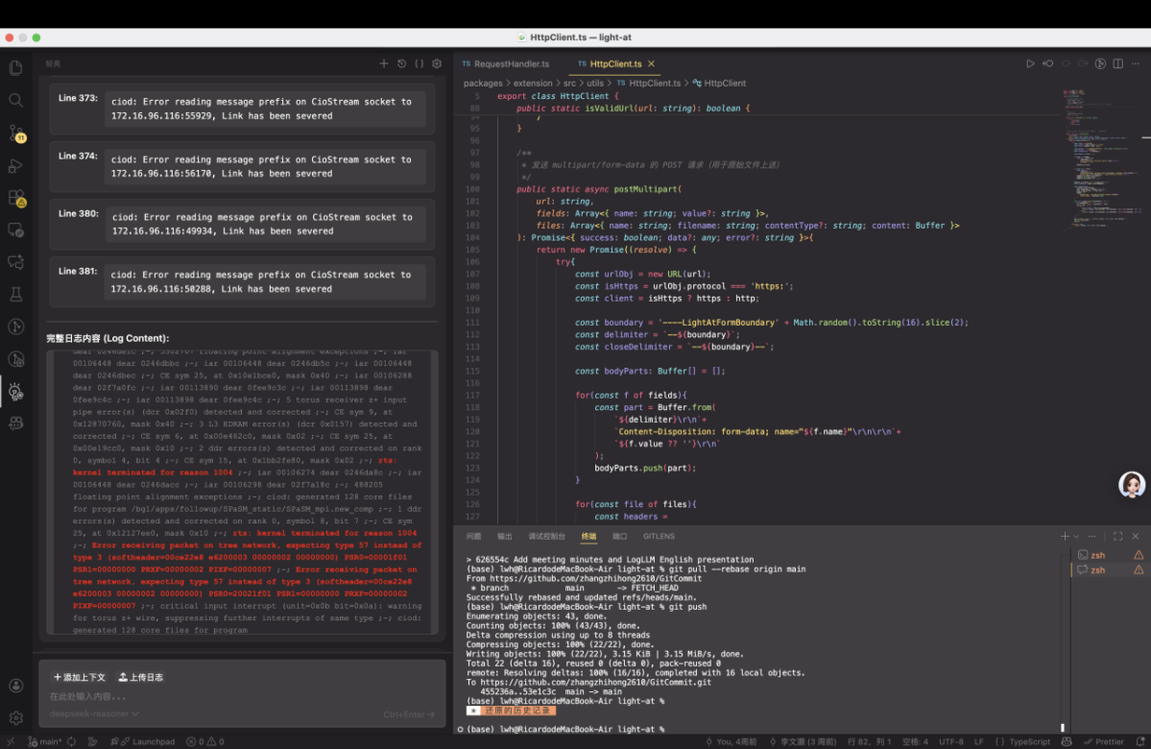
04- User Experience Flow- 2
Highlighted
Abnormal Content
展示异常内容高亮效果，帮助用户快速聚焦问题，提升排查效率。

Slide 22
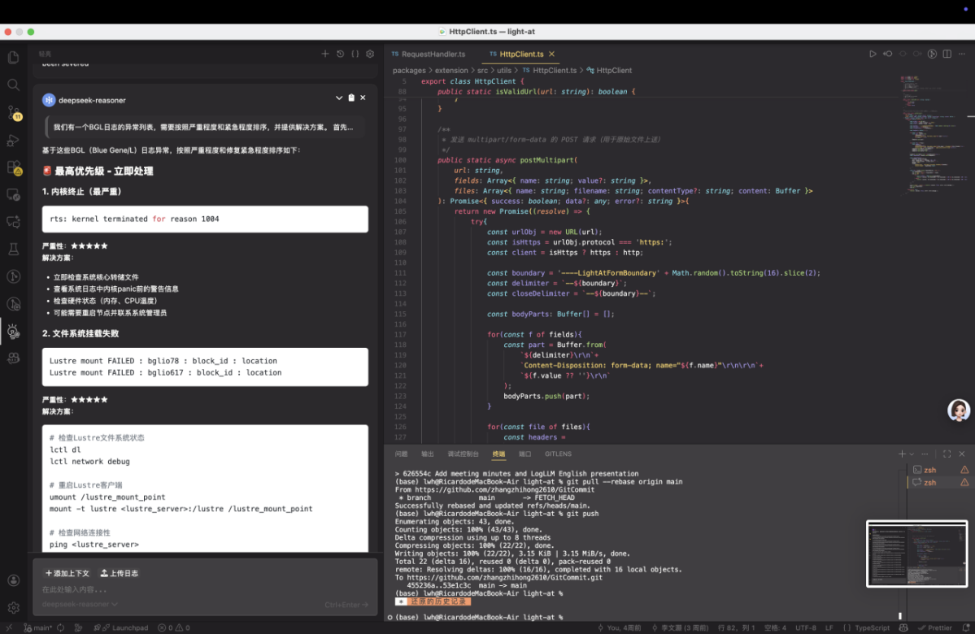
04- User Experience Flow- 3
AI Model’s
In-depth Analysis
Report on
Log Anomalies
根据问题紧急程度排序给出解决方案。展示AI深度分析报告，突出结论可溯源特性，为问题解决提供有力支持。

Slide 23



04-测试
测试准备
用例执行
缺陷管理
搭建多环境测试矩阵，准备测试数据与工具，组织测试人员培训，为全流程测试奠定基础
按 P0（阻断级）→P1（高优先级）→P2（中优先级）→P3（低优先级）优先级执行测试用例，详细记录执行结果与缺陷信息
通过 Jira 记录缺陷（含复现步骤、预期 / 实际结果、截图），跟踪修复进度，并对已修复缺陷开展回归测试

Slide 24
05
项目成果与未来工作

Slide 25
05- 过程技术工具与团队多维成果（待修改）
过程成果
技术成果
工具成果
团队成果
该项目采用敏捷 Scrum 框架，包含为期十二周的三个 Sprint 迭代周期，为 VS Code 插件工程建立了一套可重复的开发流程。该流程规范了需求收集、技术原型设计、增量交付和迭代优化，所有 Sprint 的任务完成率均超过 90%，并与燃尽图里程碑保持一致，确保按时交付。
实现了两项核心技术创新：（1）本地部署 LogLLM 模型消除对第三方 LLM API 的依赖，避免数据域外风险； (2) 基于正则表达式的动态隐私掩码机制，在保持日志语义完整性的同时，实现对敏感信息100% 的准确率；（3）对问题的紧急程度做排序，并给出解决方法。
VS Code 插件 已完成，其特点包括：支持无限制的日志长度处理（通过流式和分块策略）、支持解析Loghub数据集中八种常见类型的异常日志以及可自定义的隐私掩码规则。在日志解析任务中实现了 92.3% 的识别准确率，与SigLLM 等主流工具相比，响应速度大大提升。
建立一个跨职能协作模式，整合前端（TypeScript/Vue.js）、后端（Node.js/Python）和算法模型（LLM 微调）。该模式总结出了三项最佳实践：模块化架构设计以实现低耦合/高内聚；前后端之间标准化的 API 通信协议；以及针对日志处理边缘场景的边界测试用例设计。

Slide 26

05- Competitive Analysis
Advantages Over Existing Solutions
Our plugin offers AI-powered anomaly detection, real-time analysis, semantic understanding, and native VS Code integration. These features set it apart from traditional tools.

Slide 27
05- Project Impact & Future Work
Immediate Impact
Future Enhancements
The plugin reduces debugging time by 60% and enables proactive system monitoring. This immediate impact enhances developer productivity and system reliability.
Future work includes multi-language log support, cloud integration, team collaboration features, and advanced visualization. These enhancements aim to expand the plugin's capabilities.

Slide 28
05- Team Reflection & Learnings
Technical Learnings
Collaboration
Project Management
Innovation
The team gained deep experience in optimizing deep learning models for efficient deployment. This technical expertise will be valuable for future projects.
Agile practices improved cross-functional coordination within the team. Effective collaboration ensured smooth progress throughout the project.
Balancing scope with timeline constraints was a key lesson in project management. This experience will inform future project planning and execution.
Transitioning academic research into a production-ready tool highlighted the importance of iterative development and user feedback. This process fostered innovation.

Slide 29
THANKS
感谢您的观看
Goup: GitCommit
日期：2025/11/19

